Slide 1
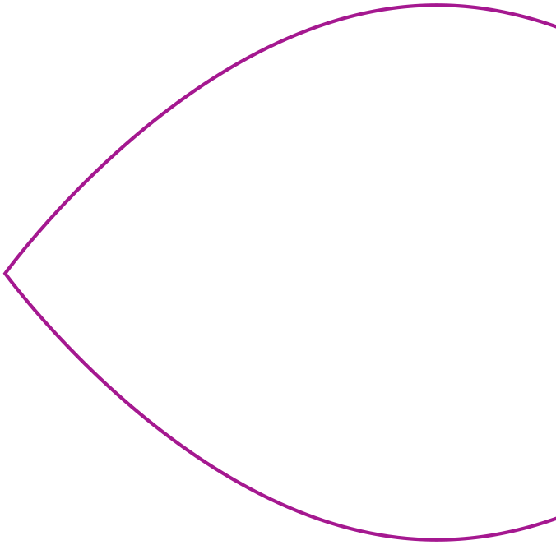
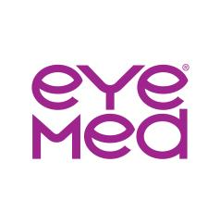
WELCOME TO EYEMED
Vision benefits for every
set of eyes!
Wesleyan University

Slide 2
Why it’s smart to enroll in vision benefits
1
The network where you want to go are:
The right mix of providers - independent, plus national and regional retail
Several online, in-network options
Pop-Up and mobile clinics right at our clients’ facilities
2
Benefits that can help take dollars go further
Enhanced benefits with low member out of pocket amounts
Flexibility with freedom of choice
Extra ways to save
3
An easy and transparent experience
Customer Care Center excellence
Online and mobile support tools
Cost transparency tools

Slide 3


Value and Wellness:
It’s all yours with EyeMed
Focus on value
Focus on wellness
Save an average of 71% off retail on eyeglasses with an eye exam¹
Choose from more than 100K network provider access points, including independent eye doctors and top optical retailers
Get members-only offers and everyday discounts, like 40% off a complete additional pair of glasses³
Help spot some serious eye and health conditions sooner with a comprehensive eye exam
Protect your eyes from digital eye strain, which is linked to blurred vision, dry eye and headaches
Easily find an in-network eye doctor, and manage claims and benefits with online member tools
1 Based on weighted average of sample transactions; EyeMed Insight network/$10 exam co-pay/$10 materials co-pay/$120 frame or contact lens allowance
2 EyeMed Insight network, All network data, October 2019
3 At participating in-network providers

Slide 4
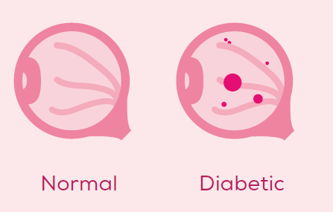
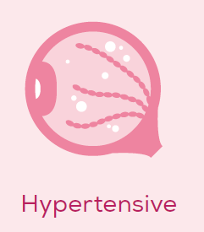
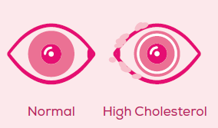
Positive impacts start with a routine eye exam
Vision conditions and diseases that can be spotted with an exam:
Myopia (nearsightedness)
Hyperopia (farsightedness)
Presbyopia
Astigmatism
Glaucoma
Cataracts
Diabetic retinopathy
Macular degeneration
General health conditions that can also be detected:¹
Diabetes
High blood pressure
High cholesterol
And more

Slide 5



Your vision coverage at-a-glance
Select Network
Frames: $150 allowance every 2 Calendar Years
Lenses: $20 copay Once every Calendar Year
Contacts: $150 allowance every Calendar Year
Plan allows the member to receive either contacts and frame, or frame and lens services.
Fully insured plans are underwritten by: Fidelity Security Life Insurance Company®, Kansas City, MO 64111.

Slide 6


Find your best fit
You’re on EyeMed’s SELECT network,
so, you’ve got choices - lots of them
More than 120,000 provider access points at 25,000 locations, including:
Plus, your local retailers:
America’s Best, Cohen’s Fashion Optical, Eyeglass World, Sterling Optical
and many more
Plus, online options:

Slide 7


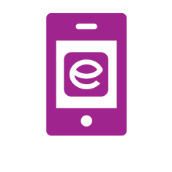

How to find an eye doctor
Use the Provider Locator
at eyemed.com
Download and use the EyeMed Members App
(available in the App Store or Google Play)
Check the listing of the closest
eye doctors from your Welcome Kit (you’ll get this after you enroll)

Slide 8
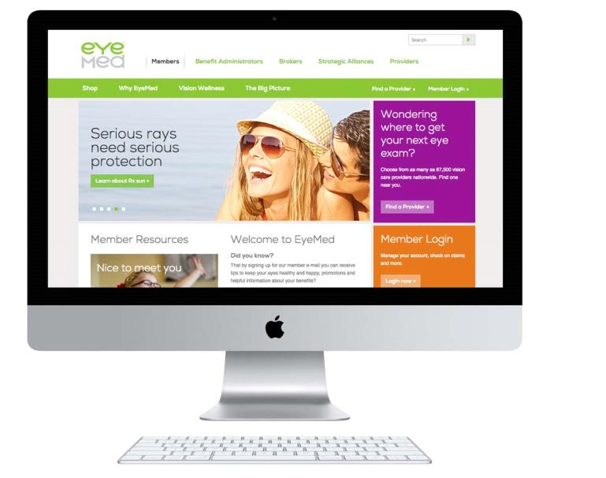
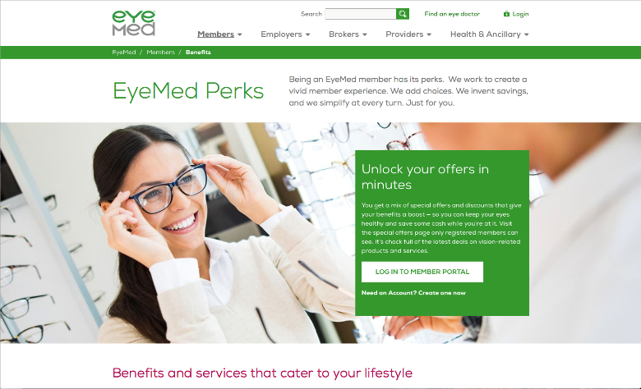
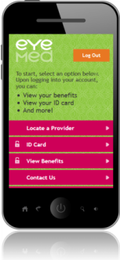
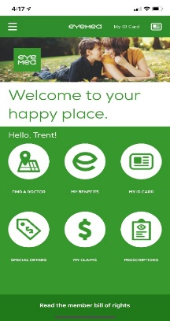
Experience more with member tools
You’ll receive an in-home Welcome Kit detailing your new vision benefits and the closest eye doctors. And using your benefits couldn’t be easier with access to convenient digital tools.
EyeMed Members App
  Benefits, eligibility and claims at-a-glance
  Find an eye doctor and get door-to-door directions
  Grab special offers
  Load and save prescriptions
  Set exam and contact lens reminders
  Pull up ID card and add to your wallet (for iOS only)
Member Web
See benefits and eligibility status*
View Savings Dashboard
Estimate out-of-pocket costs before your visit to the eye doctor
Download ID cards and EOBs
Find an eye doctor
Check claim status
Get special offers
*Due to HIPAA regulations, members will not be able to view dependents over the age of 18

Slide 9
Know Before You Go Cost Transparency Tool
  Our Know Before You Go calculator¹ lets members estimate their costs upfront:
  Members choose anticipated services and products.
  Easy-to-understand explanations of different types of frames, lenses, add-ons and contacts
  are included.
  They see their plan-specific estimated out-of-pocket cost total (if any).
Why 99% agree our benefits are easy to understand²
¹Excludes the following plans: reseller, exam-only, safety & VDT, global allowance and declining balance. ²EyeMed Client Satisfaction Survey conducted by Walker, 2020.

Slide 10

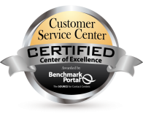
Award-Winning Service
Day and Night
Here for members whenever they need us
    “Certified Center of Excellence” rating for high customer support, 10 years in a row¹
    Available 102 hours per week:
    Mon. to Fri.: 7:30-11 p.m. EST, Sat.: 8-11 p.m. & Sun.: 11-8 p.m. EST support 362 days a year
    Need-based routing so calls are answered by
    the right vision benefits expert every time
    Mobile chat available via smartphone for callers who opt-in
    One of America’s highest-rated call centers
9 Seconds to answer
>99% 1st call resolution²
¹Purdue University Benchmark Portal independent assessment of call centers nationwide, 2019. ²EyeMed book of business data, 2019.

Slide 11

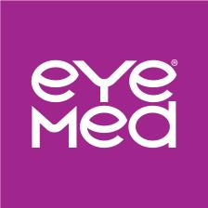

Thanks for
your time.
Have a wonderful day!
Learn more at eyemed.com
PPT-2009-M-656

